Slide 1
Sockets
Andrew Beatty
Andrew.Beatty@gmit.ie
Programming for Cybersecurity

Slide 2
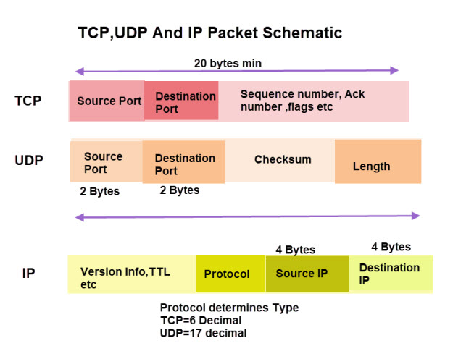
Sockets
TCP (synchronous, SOCK_STREAM)
UDP (asynchronous, SOCK_DGRAM)
Programming sockets allows us

Slide 3
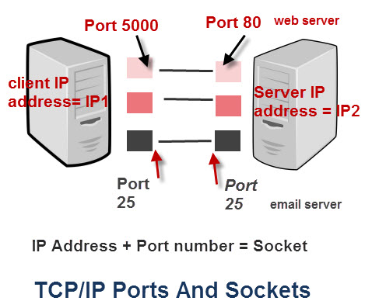
Programming Sockets allows us
Make Applications
This is beyond the scope of this course
Make our own client
Penn testing
Make our Servers
EG for honey pots

Slide 4
Some Ports
Protocol | Port | Type
FTP | 20/21 | TCP
SSH | 22 | TCP
Domain Name Service | 53 | TCP/UDP
HTTP | 80 | TCP
Network Time Protocol | 123 | UDP
Source: TCP/IP Ports and Protocols | TCP/IP Ports and Protocols | Pearson IT Certification

Slide 5
If you want to connect to APIS use request
# sample http request
# author: Andrew Beatty
import requests
host = 'http://andrewbeatty1.pythonanywhere.com'
url = host + '/books'
response = requests.get(url)
print(response.status_code)
print(response.content)

Slide 6
Client side Socket
import socket # for socket
import sys
host = 'andrewbeatty1.pythonanywhere.com'
resource = '/books'
method = 'GET'
s = socket.socket(socket.AF_INET, socket.SOCK_STREAM)
#http port
port = 80
host_ip = socket.gethostbyname(host)
# connecting to the server
s.connect((host_ip, port))
httprequest = method + ' ' + resource + ' HTTP/1.1 \r\nHost:'+host+'\r\n\r\n'
s.send(httprequest.encode())
buffer = s.recv(1024).decode()
httpresponse = repr(buffer)
# we will not get to this line
print("we got " + httpresponse)
s.close()
I have removed the error checking and comments, see code in github.
We will revisit it this
Send a simple HTTP request
Here we are receiving this in one go, that will not always be the case

Slide 7
Some things to NOte
Lots of protocols
Items may not all always be sent or received in one go
We should allow for sockets to timeout
Always close your socket when finished (you can run out of them) actually use with
Servers are slightly different.
Receive multiple requests and must make a new socket to deal with each
Implement a protocol
Netstat will let you see socket state
In windows I use tcpview (part of sys internals)
https://docs.microsoft.com/en-us/sysinternals/downloads/

Slide 8
Simple Server Code
import socket
s = socket.socket()
port = 12345
s.bind(('', port))
# put the socket into listening mode
s.listen(5)
# a forever loop until we interrupt it or error occurs
while True: c, addr = s.accept()
print('Got connection from', addr)
c.send('Thank you for connecting'.encode()) c.close() # when finished with the socket
Simplified, no error checking and reduced comments
The port can be anything
No ip given so this can be connected to by anyone
Allow 5 socket requests to queue before rejecting a connection
This does not read in anything from the client, it just sends a response
It would be better to use with

Slide 9
An echo server
#!/usr/bin/env python3
import socket
HOST = "127.0.0.1" # Standard loopback interface address (localhost)
PORT = 65432 # Port to listen on (non-privileged ports are > 1023)
with socket.socket(socket.AF_INET, socket.SOCK_STREAM) as s:
s.bind((HOST, PORT))
s.listen()
conn, addr = s.accept()
with conn:
print("Connected by", addr)
while True:
data = conn.recv(1024)
if not data:
break
conn.sendall(data)
This will close the socket when finished (or error)
Keep reading from the client until the client closes the conenction
Send all will keep sending the data until it is all sent

Slide 10
Designing your protocol (or implementing one)
Data is sent as bytes, so need to be encoded and decoded
Headers
Dealing with multiple requests.
Threaded
Data is sent as bytes, so need to be encoded and decoded
Different OS store integers in different ways (big-endian vs small-endian)
How long should the socket keep receiving for.
Fixed amount of bytes or variable
Be careful about vulnerabilities
Eg a webserver, serving out files

Slide 11
Real protocol (HTTP)
HTTP header is sent and response is made. The header has
A Request-line
Zero or more header (General|Request|Entity) fields followed by CRLF
An empty line (i.e., a line with nothing preceding the CRLF) indicating the end of the header fields
Optionally a message-body

Slide 12
Some code (simple http server)
This still only takes one connection
with socket.socket(socket.AF_INET, socket.SOCK_STREAM) as s:
s.bind((HOST, PORT))
s.listen()
conn, addr = s.accept()
with conn:
readingheader = True
readbuffer = b""
while readingheader:
readbuffer += conn.recv(4098)
read_string = readbuffer.decode()
endHeader = read_string.find('\r\n\r\n') # an empty line
headerString = read_string[:endHeader]
readbuffer = readbuffer[endHeader+4:] # the body if there is one
header = proccess_header(headerString)
readingheader = False
responseString = '' + header['protocol'] + ' 200 OK\r\n\r\na page\n'
conn.sendall(responseString.encode()) # ok this should be doing a bit
There is a much neater way of doing this
This is a clunky way of dealing with the byte arrays and strings
I’ll come to this

Slide 13
The process header
GET /hello.htm HTTP/1.1
User-Agent: Mozilla/4.0 (compatible; MSIE5.01; Windows NT)
Host: www.tutorialspoint.com
Accept-Language: en-us
Accept-Encoding: gzip, deflate
Connection: Keep-Alive
Sample http header
Note the empty line at the end
def proccess_header(rawHeader):
lines = rawHeader.split('\r\n')
print (' we got ', lines , 'in the header')
header = {}
# process the request line we should have some error checking here
requestEntities = lines[0].split(' ')
header['method'] = requestEntities[0].strip()
header['resource'] = requestEntities[1].strip()
header['protocol'] = requestEntities[2].strip()
# we should process the header attributes here
return header

Slide 14
Multiple connections
Each connection should be handles separately and concurrently, we can:
Ignore this (for servers with a very very low load
Threads (high load servers)
Selectors, a python library designed for dealing with I/O (waiting and concurency, this is single threaded)
You register the io stream with:
the selector
a mask for read, write or both
An object that can be used to store data for that stream
You call select, this is blocking and returns:
The key (the stream and the data for that stream, and other information
The channel that is ready (read or write)

Slide 15
Server code
lsock = socket.socket(socket.AF_INET, socket.SOCK_STREAM)
lsock.bind((host, port))
lsock.listen()
lsock.setblocking(False)
sel.register(lsock, selectors.EVENT_READ, data=None)
try:
while True:
events = sel.select(timeout=None)
for key, mask in events:
if key.data is None:
accept_wrapper(key.fileobj)
else:
service_connection(key, mask)
except KeyboardInterrupt:
print("caught keyboard interrupt, exiting")
finally:
sel.close()
register
Wait for a read or write
The listening socket has no data
I will look at these functions next
Accept_wrapper (make socket for connection)
Service_connection (deal with connection requests)

Slide 16
Accept_wrapper
def accept_wrapper(sock):
conn, addr = sock.accept() # Should be ready to read
print("accepted connection from", addr)
conn.setblocking(False)
data = types.SimpleNamespace(addr=addr, inb=b"", outb=b"")
events = selectors.EVENT_READ | selectors.EVENT_WRITE
sel.register(conn, events, data=data)
Creates an object
Byte arrays to act as buffers for read and write

Slide 17
Process request
def service_connection(key, mask):
sock = key.fileobj
data = key.data
if mask & selectors.EVENT_READ:
recv_data = sock.recv(1024) # Should be ready to read
if recv_data:
data.outb += recv_data
else:
print("closing connection to", data.addr)
sel.unregister(sock)
sock.close()
if mask & selectors.EVENT_WRITE:
if data.outb:
print("echoing", repr(data.outb), "to", data.addr)
sent = sock.send(data.outb) # Should be ready to write
data.outb = data.outb[sent:]
This is an echo server, so
send what we receive to the output buffer.
We are no longer interested in this socket, when we close it

Slide 18
In the python tutorial folder there is a sample application

